Slide 1

Geneva as a Digital Governance Hub
Applied Research Project
06.11.2024
Joëlle Fuchs, Oskar Kohlbrenner, Peiwen Cai & Shabon Jones

Slide 2
Structure
Overview of the Applied Research Project
Case studies
Expert Interviews
Foresight Analysis
Synthesis of findings
Recommendations

Slide 3
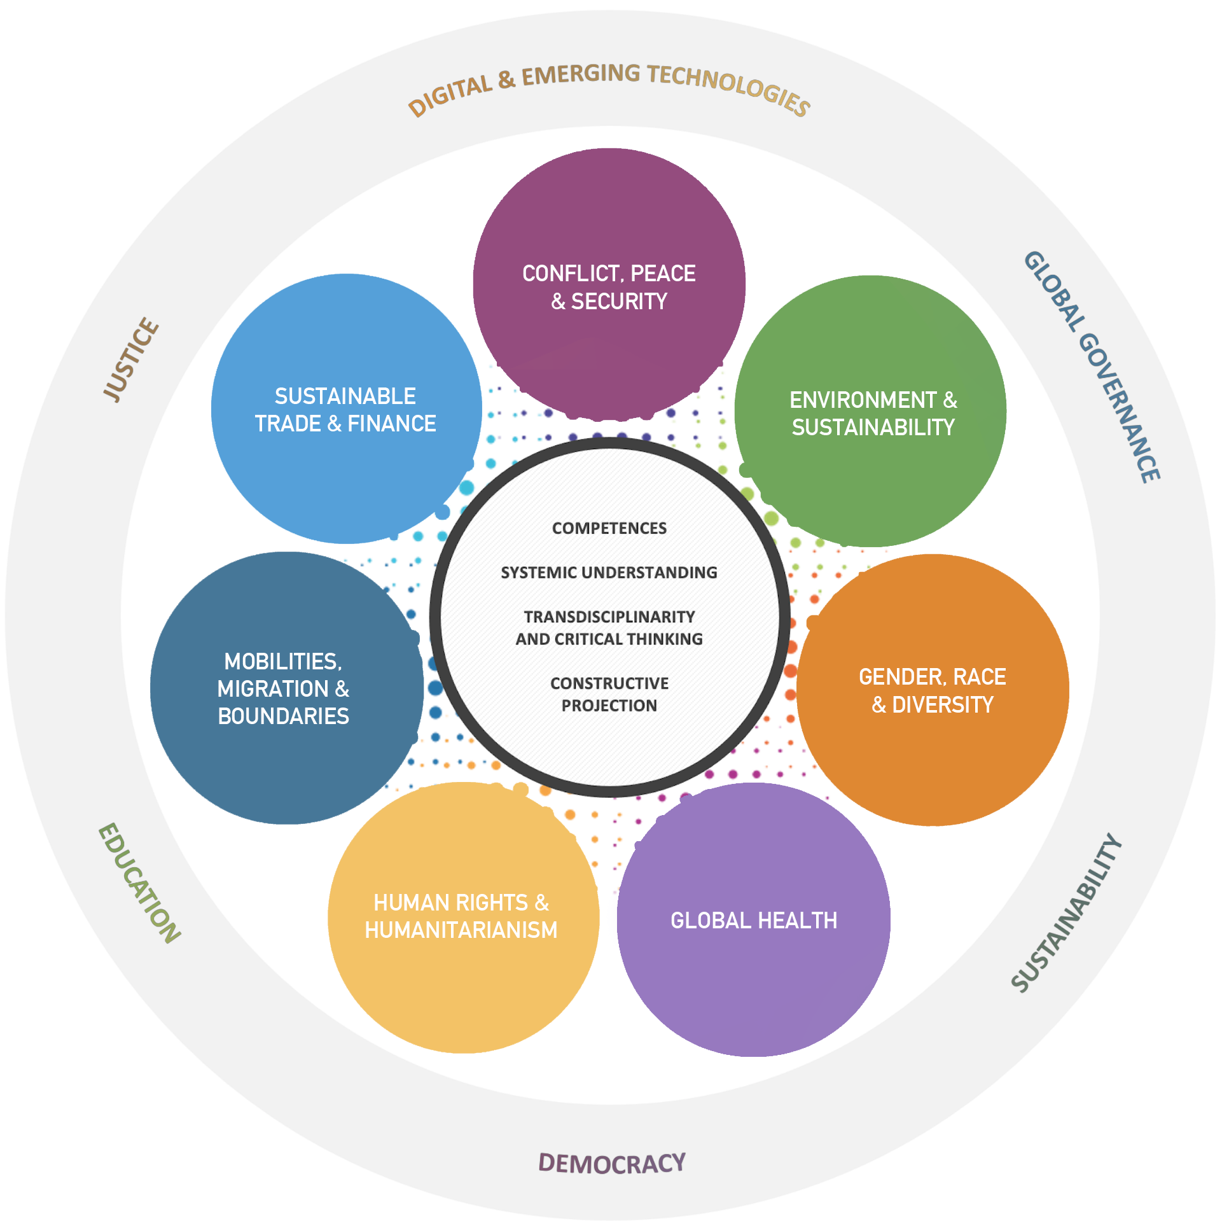
Applied Research Project
Permanent Mission of Switzerland to the UN and other IOs in Geneva
Beneficiary
Hassan Thuillard
Project Partner
Jérôme Duberry
Academic Supervisor

Slide 4
Geneva Digital Governance Hub
As a host state, how can Switzerland maximize Geneva’s potential as a global digital governance hub?
How can Geneva enhance its collaborative ecosystem for digital tech governance and develop governance mechanisms?
Policy Recommendations

Slide 5
Methodology
Expert Interviews
Foresight Analysis

Slide 6

Project Timeline
Supplementary Interviews
Horizon Scanning
& Driver Mapping
Literature
Review
Workshop
Recommendations
Preliminary
Interviews
Scenario
Building
Synthesis
of Results
Integration of Feedback

Slide 7
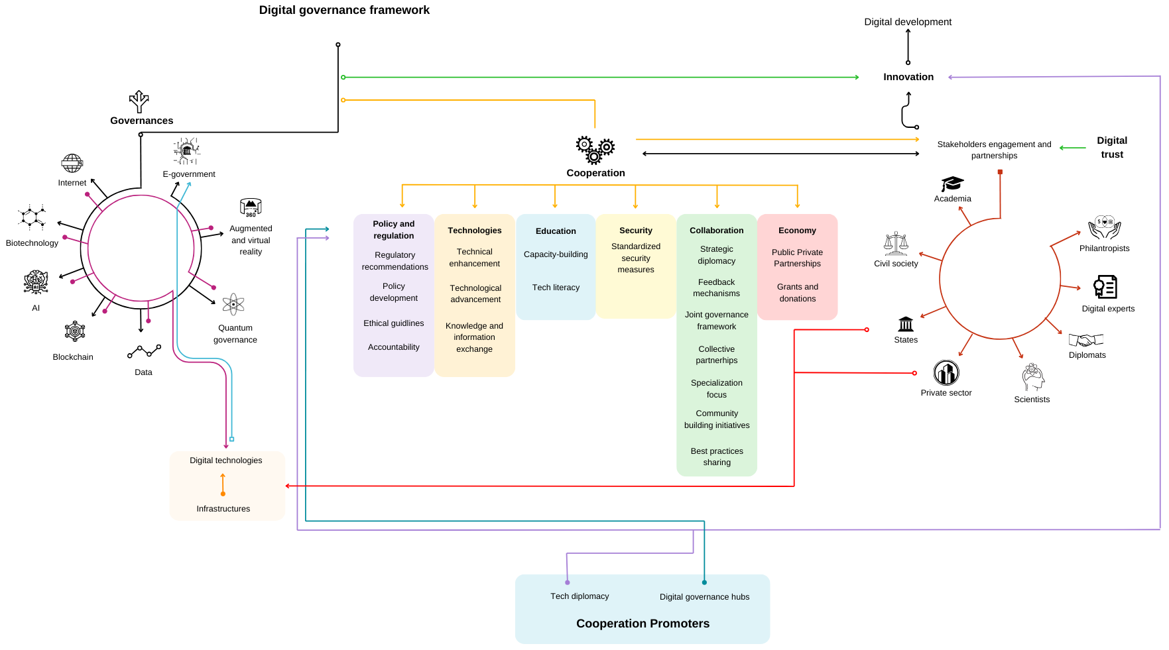
Digital Governance

Slide 8
Case Studies
Zoom-In
Zoom-Out
Geneva Human Rights Platform
San Francisco
Geneva Global Health
China
Applicable Findings
Academia as a collaboration promoter
Exchange of best practices
Geneva’s historical ecosystem
Bottom-up approaches
Applicable Findings
Tech diplomacy as a bridge between policymakers and tech experts,
Academic excellence and venture capital as critical tech enablers,
Disruptive tech as a layer of unpredictability,
China fostering an alternative approach to tech development

Slide 9
Expert Interviews
Ambassador Benedikt Wechsler
EDA
Adam Day
UN University
Anton Aschwanden
Google
Maricela Munoz
GESDA
Ambassador Benjamin Rothen
FSO
Yongling Cheng
Guangdong University
Lennig Pedron
Trust Valley
Sorina Teleanu
DiploFoundation
Romain Darioli
DFAE
Domenico Zipoli
Geneva Academy
Antonio Gambardella
FONGIT
Davide Fanciulli
SDG Lab
Jorge Cancio
OFCOM
Maxime Stauffer
Simon Institute
Marc Løebekken
Proton
Steve MacFeely
WHO
Alexander Barclay
State of Geneva

Slide 10
Interview Findings
Today
Lack of private sector participation (digital rights)
Need for state-led initiatives
Missing Global South (inequalities)
US companies dependence
Main institution should remain relevant
Importance of Swiss neutrality
Tech literacy
Lack of consensus and cooperation (regulations, silo, regional differences)
Importance of anticipation science

Slide 11
Interview Findings
Future
Increase of inequalities
Increasing importance of private companies + collaboration with policymakers
Decentralization
Competition for monopolisation
Neutrality
More policies and data spaces
Organizations moving away + other hubs

Slide 12




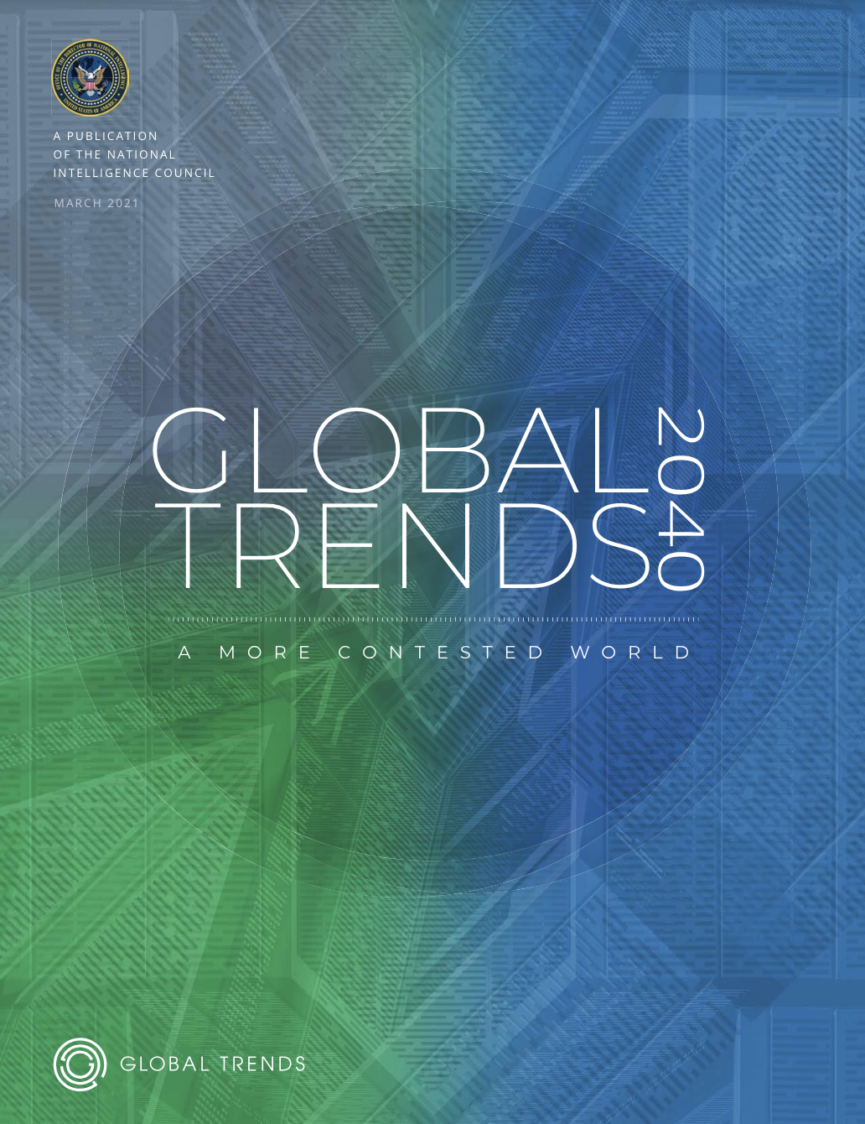

Foresight Methodology
Interviews

Slide 13
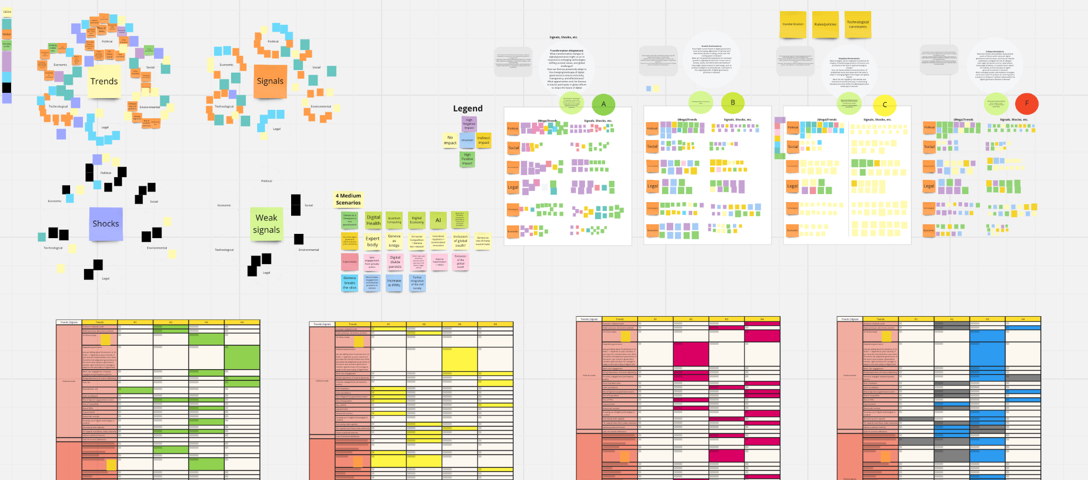
Horizon-Scanning & Scenario-Building Process

Slide 14
Future Scenarios
Specialization
Scenario 1 - Geneva leads digital governance in one specialization
Decentralization
Scenario 2 - Geneva hosts digital governance discussions, linking existing and emerging international hubs
Fragmentation
Scenario 3 - The digital governance landscape becomes increasingly fragmented with new multilateral structures led by BRICS, decreasing the leadership of the International Geneva
Collaboration
Scenario 4 - Geneva strengthens public-private partnerships and fosters a more collaborative ecosystem, further integrating private and civil society actors

Slide 15
Workshop
Interactive
Small Group
Discussions
Open-Ended
Large Discussion
Group 1
Group 2
Beatrice Ferrari
Canton of Geneva
Adam Day
UN University
Yannick Heiniger
Giga Learning Hub
Konrad Seifert
Simon Institute
Yejin Lee
UNIGE
Lennig Pedron
Trust Valley
Yung-Hsuan Wu
DiploFoundation
Domenico Zipoli
Geneva Academy

Slide 16
Workshop Findings
Specialization
Decentralization
Fragmentation
Collaboration
Lack of representation of Global South
Geneva's strength
international public policies
The robust governance structure of International Geneva
Emerging technologies
The lack of private sector participation
Geneva's role
as a bridge for governance discussions
Further polarization between
the US and China
Key dynamic in shaping global governance
Technology silo
Potential decentralization of the UN

Slide 17
Synthesis of Findings & Recommendations
01
Strengthen tech literacy in Geneva
Prepare the next generation of policymakers
Establish an information center
Nurture Tech Literacy & Awareness-Building
02
Establish a dual hub Geneva-Zurich
Invest in digital infrastructure
Incentivize bottom-up tech innovation
Invest in Physical & Digital Infrastructure
03
Enhance existing and establish new innovation parks
Augment multi-stakeholder collaboration
Support creation of a new institution
Fostering Multi-Stakeholder Collaboration

Slide 18
Synthesis of Findings & Recommendations
04
Extend science diplomacy initiatives
Push Geneva’s image as a tech leader
Promote international, public-private tech development
Enhance Geneva’s Global Position
05
Support reforming international governance structures
Advocate for the establishment of a crisis management center
Harmonize bottom-up initiatives
Address Governance Gaps
06
Promote multilateralism through multi country initiatives
Form new alliances
Prevent Fragmentation

Slide 19
Thank you for your attention and participation

