Slide 1

Feasibility Study for an
International Metadata Platform
The Trusted Data Observatory
Geneva, November 2024
Pádraig Dalton

Slide 2

Start at the beginning - who am I?
Worked in Central Statistics Office in Ireland for 33 years - joined 1991!!
Chief Statistician (Director General) for 12 years May 2012 – May 2024
Retired from CSO and Irish Civil Service at the end of May 2024
International experience – ESS/Eurostat, UNSC, UNECE Conference of European Statisticians, HLG MOS etc
Now work on a consultancy basis

Slide 3
Context for our work
“Data are the lifeblood of decision-making and the raw material for accountability. Without high-quality data providing the right information on the right things at the right time; designing, monitoring and evaluating effective policies becomes almost impossible”.
Evidence based decision making
People’s right to live in an informed society
We must be RELEVANT & TRUSTED
Our figures must reflect the lived reality of people

Slide 4

Background to report
Feasibility of creating a Global Metadata Platform in Geneva
Swiss Federal Department of Foreign Affairs in collaboration with the Federal Statistics Office of Switzerland

Slide 5

Key research questions (1 of 2)
Assess the appropriateness and coherence of the project vision in relation to its overall objectives
Assess potential value added for data owners
Identify relevant examples of already existing metadata platforms across regions and countries and which projects are currently under development
Outline potential functionalities of the platform
Scope of the platform
Suggest criteria for the selection of (meta-)data to be referenced on the platform

Slide 6

Key research questions (2 of 2)
Identify realistic phases for the creation and implementation of the platform and suggest an approximate timeline
Identify potential individuals to be involved in a pilot phase and in later stages of implementation, and their respective roles
Assess the suitability of Geneva as the location for the platform
Identify opportunities and risks in the different phases of the project
Estimate which different cost factors (incl. staff requirements) there would be in developing (including the different steps) and maintaining the platform, including cost estimates where possible

Slide 7

Why – What is the burning platform?
Crowded data market – competitive & un-regulated
Difficulty in finding/discovering “trusted” data in the crowded data market – a data swamp
Proliferation, even of trusted data platforms, with diverging approaches to metadata – mitigates against discovery, and, also transparency
How users find and consume information – trawl virtual world
Convenience – easy to find, easy to use, ready to go
Do users want answers now, more than search results? Is this the direction of travel, influenced by AI?
Fake news and alternative facts
Emerging technology and methodologies – e.g. AI/ML

Slide 8
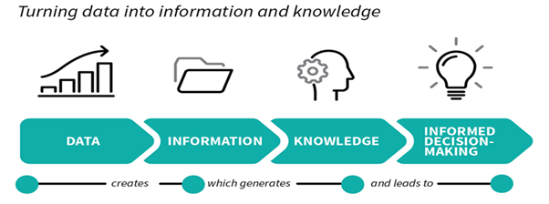
Understanding the role of data

Slide 9

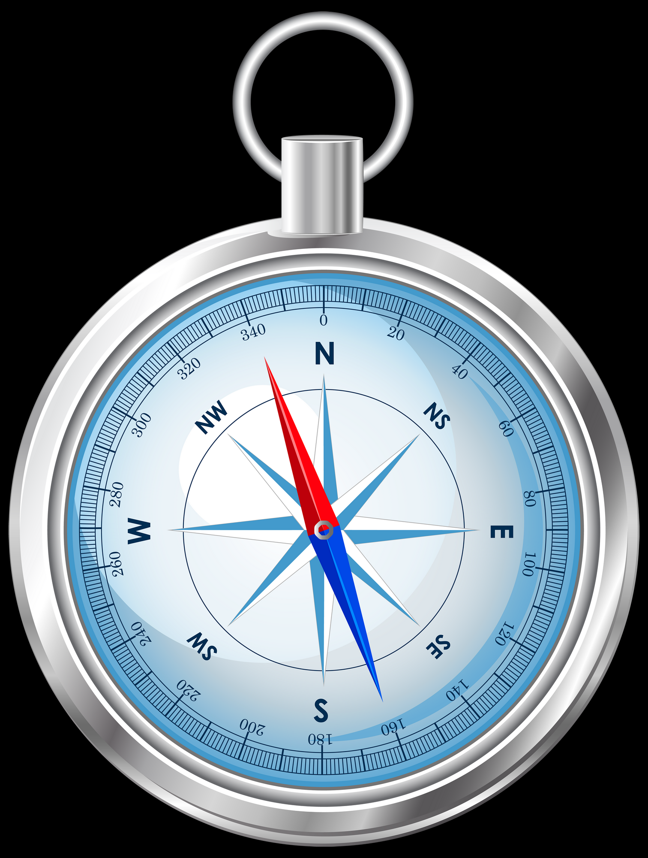
The need for a Compass!
We can’t use, what we can’t find, and don’t TRUST
Discoverability
Comparability
Accessibility
Metadata

Slide 10
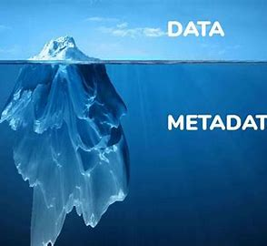
The age of discovery - Metadata
Metadata is “data about data”
Traditionally find “metadata” through “data” – very much still the case
But we now operate in a “machine readable” world
Means we need to invert the graphic
Metadata is key to discovery and transparency
Minimum Viable set of Metadata (MVM)

Slide 11
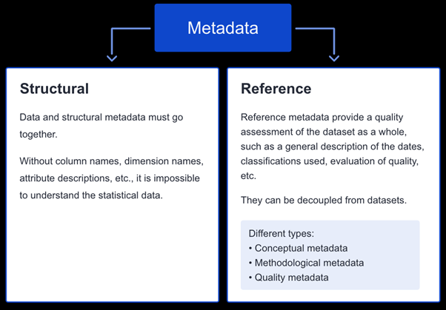
Metadata (2 of 2)
Structural, Descriptive, Reference, Administrative,
Data Document Initiative – Resource Definition Framework (DDI-RDF)
DCAT – Data Catalogue Vocabulary
Dublin Core
SDMX
GSIM
IMF SDDS
Source: Eurostat

Slide 12

Global Metadata Platform – Trusted Data Observatory
Metadata Platform NOT a Data Platform
Data stays where it is
Decisions on access rests with Data Compiler
Only supports discovery of Trusted data
Focus is metadata to support - Discovery, Comparability & Accessibility
Machine readable and AI enabled
Harmonised and standardised metadata
TDO
User search/request
Directed to “trusted” data
Metadata

Slide 13
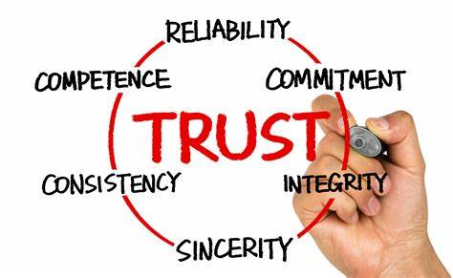
Scope - Trusted Data
How do we identify “Trusted” Data
Presence of quality metadata – always a good starting point
Need to make some assumptions – initially at least
Data holdings of National Statistical Institutes (NSIs) and statistically focussed International Organisations (IOs such as Eurostat, World Bank, IMF, OECD, UNSD, ILO)
Compile in compliance with UN Fundamental Principles and recognised international standards
Recognised Open Data platforms?
In time will need to consider other potential sources – e.g. private data holdings from highly regulated and licensed domains

Slide 14
Scope – Trusted data products
What type of data are we “discovering”?
  Statistical releases and publications
  Aggregate Indicator Data
  Online aggregate data bases (cubes) from which users can create their own tables on the fly
  Public Use Microdata Files
  Synthetic microdata
  Research Microdata Files (restricted access – information on content, access policy, access application process - decisions on access rest with data compiler)

Slide 15
Functionality
API enabled extraction and receipt of harmonised and structured metadata
Provision of metadata that is machine readable and AI enabled supporting lexical and semantic search functionality
Once on platform the ability to refine searches by pre-defined filters (e.g. theme, data compiler type)
The ability to monitor usage of the platform
Feedback mechanism to support ongoing development and refinement
User friendly interface
Usage of AI tools on the platform to prepare reports on comparability of data holdings for a specified search (advanced – downstream iterations)

Slide 16
Examples of other platforms
Idea/concept is rather unique
Most existing platforms are:
  Data Platforms (with metadata associated to the data) or
  Metadata platforms – concepts, variable definitions, code lists and classifications
Section 11 of the report gives some examples

Slide 17

The value proposition
Discovery and visibility
Targeted search results/answers
Training algorithms
Drive usage of, and users to, trusted data
Avoid creation of metadata silo’s
Minimise compiler workload
API enabled
Scope and granularity of data products/sources
Contributes to fight against fake news and alternative facts

Slide 18

Challenges
Availability of metadata
Standardisation and harmonisation of metadata
Focus traditionally been on the data
Where metadata has been developed, it has been very much in the context of accessing metadata through data
Need to avoid creation of a metadata swamp – MVM
Governance – does a global platform need global governance?
The business model – sustainability?
Making a compelling cases to engage data compilers
Temptation to gold plate initial prototype – risk of scope creep – “need to have” vs “nice to have”
Creating an active user base – yes scope, functionality, user friendly interface – must brand & market the platform

Slide 19

The user community – the audience
Government’s
Policy makers
Non-governmental organisations
Business Community
Civil Society – the Public
The media/data journalists
Research community
Academics
Data compilers
Big tech – including Open AI, Open Source Community, Google etc.

Slide 20

Geneva – Home of the TDO
Geneva – already an international hub with a global perspective
Experience, competence resides in Geneva
Neutrality supports trust – clearly recognised “brand”
Ambition, vision, leadership resides in Switzerland
Elements of necessary infrastructure already in place – scientific and technical infrastructure

Slide 21

Next steps
Phase 1: Identification of all relevant stakeholders, and detailed engagement to identify needs and technical specification for the TDO
Phase 2: Identify and engage with potential partners to participate in the Proof of Concept (PoC) – collaboration of the willing
Phase 3: Development of prototype for PoC
Phase 4: Review and refine TDO post PoC
Phase 5: Onboarding and Post 2030 agenda

Slide 22
Costs

Slide 23
Next steps
Phase 1: Identification of all relevant stakeholders, and detailed engagement to identify needs and technical specification for the TDO
Phase 2: Identify and engage with potential partners to participate in the Proof of Concept (PoC) – collaboration of the willing
Phase 3: Development of prototype for PoC
Phase 4: Review and refine TDO post PoC
Phase 5: Onboarding and Post 2030 agenda

Slide 24
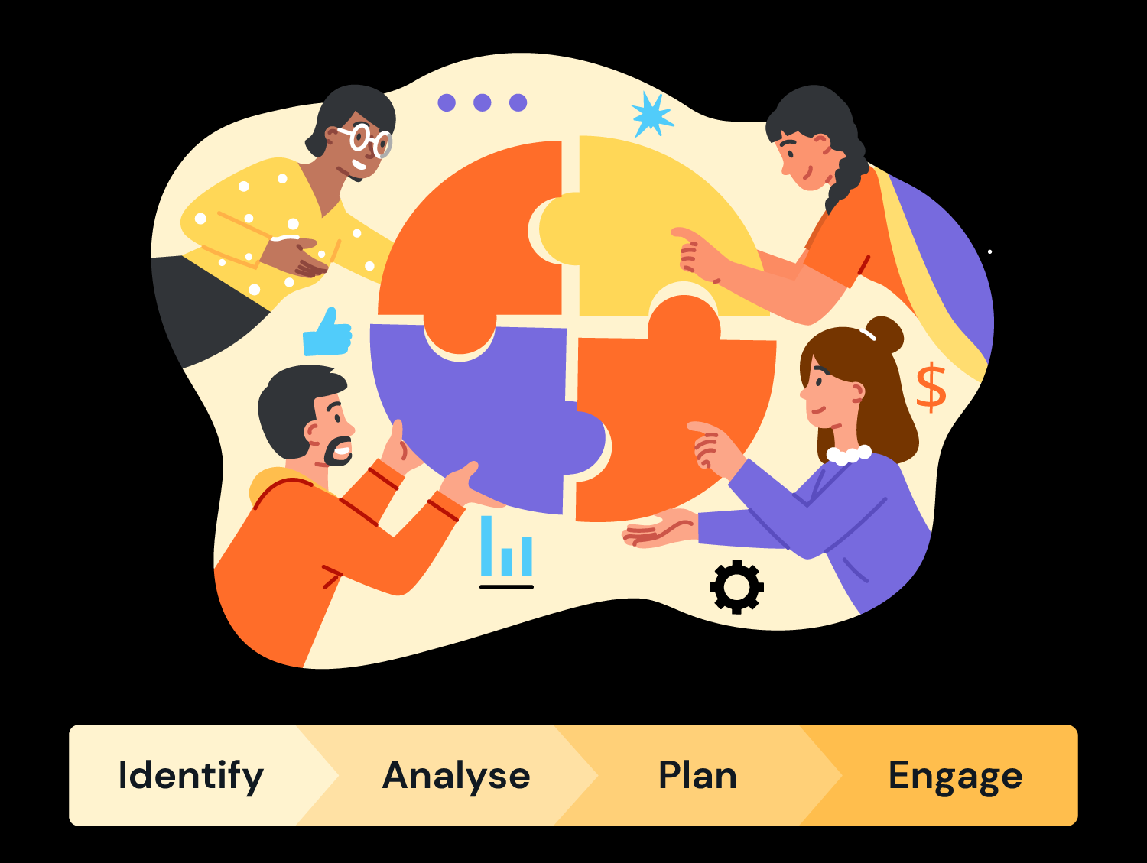
Key stakeholders in next steps
Swiss Federal Department of Foreign Affairs
Swiss Federal Statistical Office
IO’s including World Bank, OECD, Eurostat, UNSD, UNECE, IMF, ILO
Interested NSI’s – limited number initially
Philanthropic interests?
Interested universities/academics
Big Tech – when to engage?
Media/data journalists – later stages of project

Slide 25

Concluding comments
Real ambition and vision
Grounded in altruism
Grounded in existing environmental context
  Fake News/Alternative Facts
  Data Swamp – discovery challenge
Recognition of what can and can’t be achieved

Slide 26


