Slide 1

Trusted Data Observatory
Geneva Data Community
30 October 2025
Pádraig Dalton

Slide 2


Reminder to date
Feasibility report November 2024
Development of a Trusted Data Observatory
Geneva to be the home of the TDO
Challenge in finding trusted data sources in a crowded un-regulated data market
Metadata is the key – essentially the map/compass to support the visibility and discovery of data
Need to make metadata AI enabled – open and machine readable
Now moving into the implementation phase

Slide 3


The burning platform?
Crowded data market – competitive & un-regulated
Difficulty in finding/discovering “trusted” – Data Swamp
Influence of AI on the user community
Convenience generation – want everything now
Misinformation and Disinformation

Slide 4
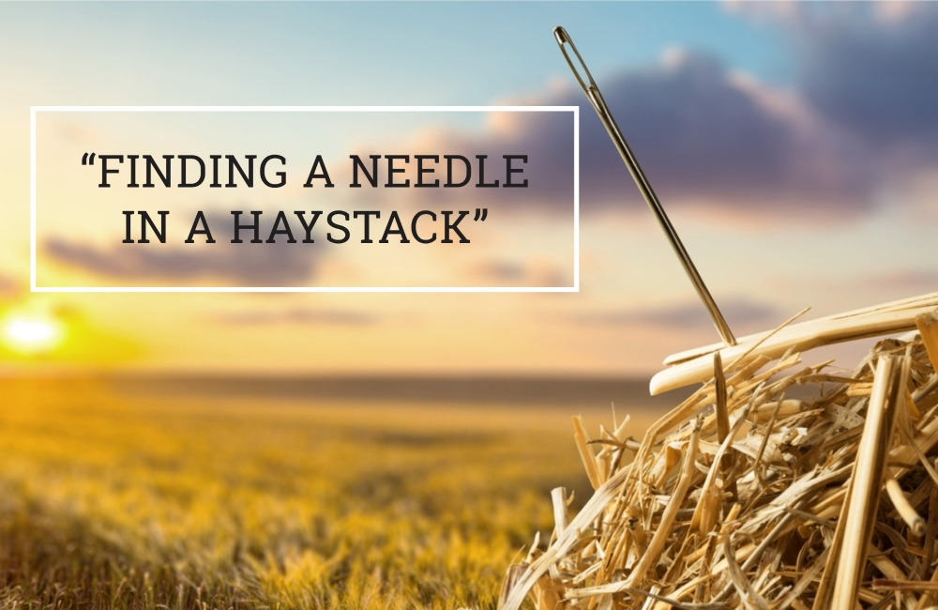
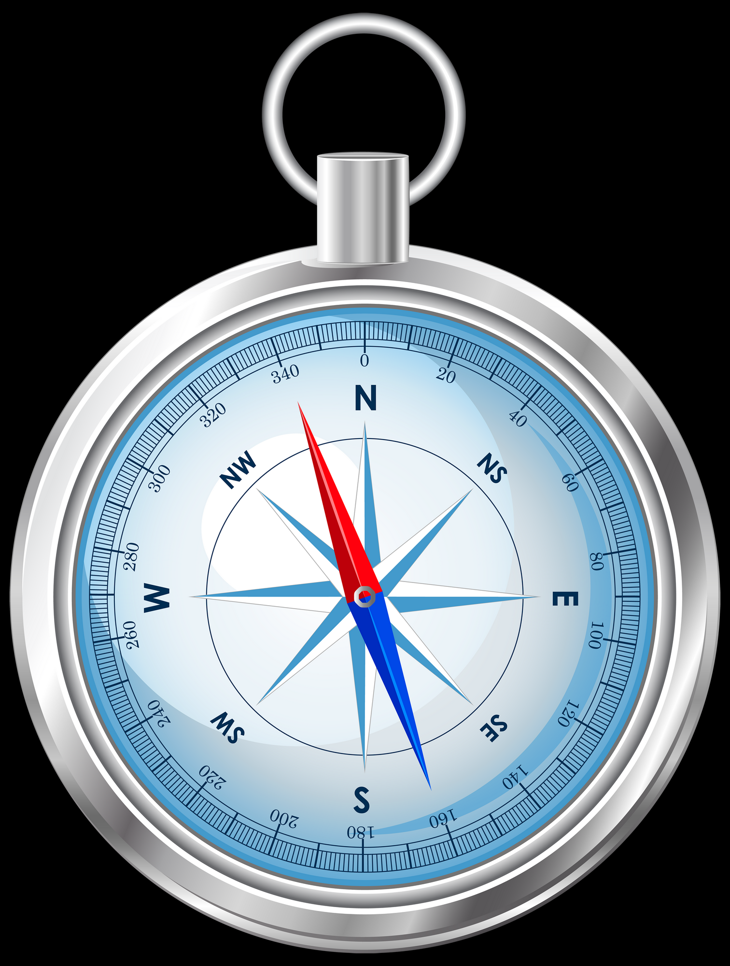
The need for a Compass!
We can’t use, what we can’t find, and don’t TRUST
Visibility
Discoverability
Accessibility
Metadata

Slide 5
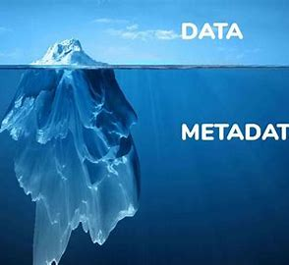
What is Metadata?
Metadata is “data about data”
Traditionally find “metadata” through “data” – very much still the case
But we now operate in a “machine readable” world
Means we need to invert the graphic
Metadata is key to discovery and transparency
Minimum Viable set of Metadata (MVM)

Slide 6

Global Metadata Platform – Trusted Data Observatory
Metadata Platform NOT a Data Platform
Data stays where it is
Decisions on access rests with Data Compiler
Only supports discovery of Trusted data
Focus is metadata to support - Discovery, Comparability & Accessibility
Machine readable and AI enabled
Harmonised and standardised metadata
TDO
User search/request
Directed to “trusted” data
Metadata

Slide 7
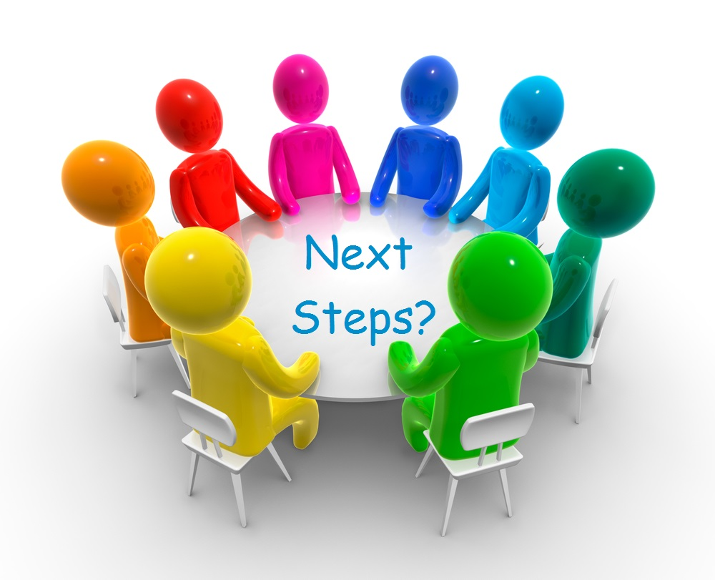

Slide 8
Phase 1 – Key elements
Planning
Operationalise governance
Influence – Who, when, how
Stakeholder engagement
Develop first prototype
Risk identification and mitigation
Broader engagement and influencing

Slide 9
Phase 2 – Key elements
Metadata – agree MVM and associated standards
Specification for the TDO
Hosting service
Proof of Concept design
Recruitment of PoC participants
Engage with big tech – Open AI community (Chat GPT), Google (Gemini), Microsoft (Copilot)
International engagement and influencing

Slide 10
Phase 3 – Key elements
Build the TDO
Put hosting environment in place
Train PoC participants
Run the PoC
Learn PoC lessons
Update the TDO based on lessons learned
Continue engage with big tech – Open AI community (Chat GPT), Google (Gemini), Microsoft (Copilot)
International engagement and influence to drive usage and by extension value
Sustainability

Slide 11
Phases 4 & 5
Phase 4: Review and refine the TDO post completion based on user experience
Phase 5: Ongoing activity focussed on “on-boarding” and how the TDO can support the post 2030 agenda

Slide 12

The value proposition
Discovery and visibility
Targeted search results/answers
Training algorithms
Drive usage of, and users to, trusted data
API and AI enabled
Contributes to fight against misinformation and disinformation

Slide 13

Challenges
Getting buy-in
Standardisation and harmonisation of metadata
Sustainability of the TDO
Creating an active user base
Engaging big technology companies to develop their AI algorithms and LLM’s to use the TDO

Slide 14
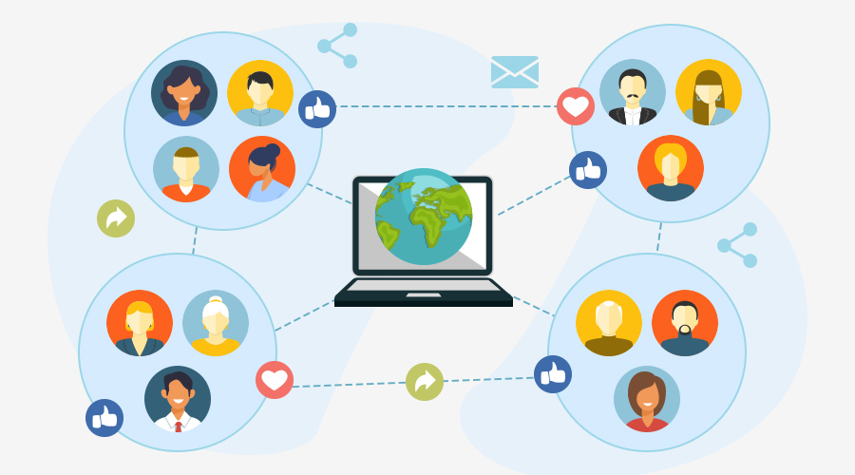
The user community – the audience
Government’s
Policy makers
Non-governmental organisations
Business Community
Civil Society – the Public
The media/data journalists
Research community
Academics
Data compilers
Big tech – including Open AI, Google, Microsoft etc.

Slide 15


